Slide 1

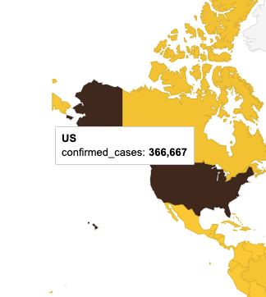
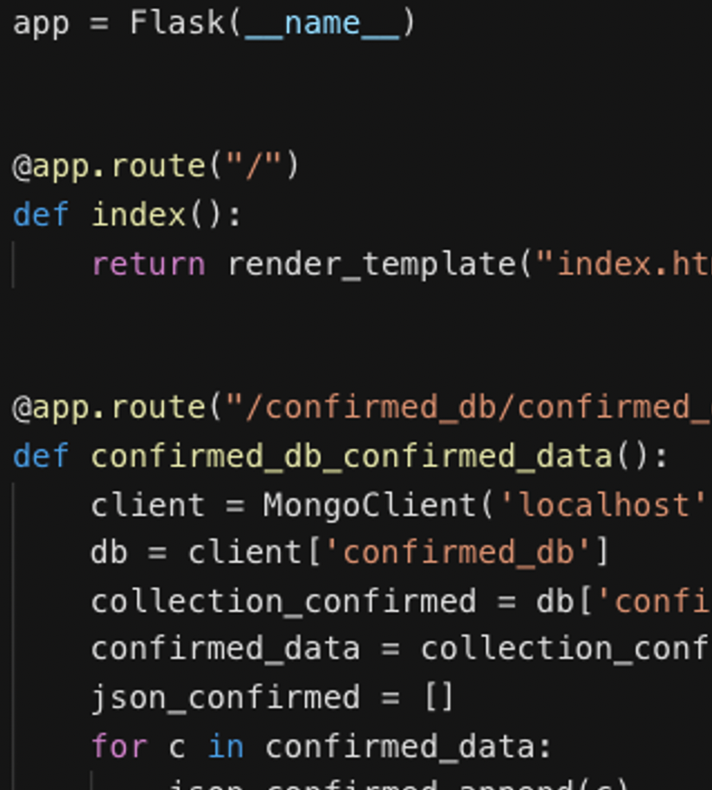
Visualizing the COVID-19 Pandemic
The Story
The Map
The Stack
Alexis Perumal
Grant Thompson
Arundhati Chakraborty
UCSD Data Science and Visualization Boot Camp, April 7, 2020

Slide 3
Visualizing the COVID-19 Pandemic
The Story
The Map
The Stack
Alexis Perumal
Grant Thompson
Arundhati Chakraborty
UCSD Data Science and Visualization Boot Camp, April 7, 2020

Slide 4
Visualizing the COVID-19 Pandemic
The Story
The Map
The Stack
Alexis Perumal
Grant Thompson
Arundhati Chakraborty
UCSD Data Science and Visualization Boot Camp, April 7, 2020

Slide 5
Libraries:
D3, Leaflet, Plotly, DC charts, Google Charts (visualization)
Axios (library to call Promises in js), Lodash (helper functions)
pymongo to interact with MongoDB (Notebook)
Flask to build the server and routing
utility files in python to grab csv and convert to json before pushing it to database
https://alexisperumal.github.io/covid-19/

Slide 6
Style Guide

Slide 7
Initial Wireframe

Slide 8
Getting and understanding the data
After downloading the csv files from the JH and NYT github page, used python script to grab the files and convert to json.
The attributes being used is :
time series dates till now, Country, Provice_State, Counties, confirmed cases, Death and Recovered.
Now that we have the data, next step is storing and querying the data using MongoDB :
- separate databases for confirmed, deaths, recovered global data till date
- separate database for confirmed and deaths for United States till now
- separate database for counties and States of US
- Used PyMongo for connecting to MongoDB and querying the data

Slide 9
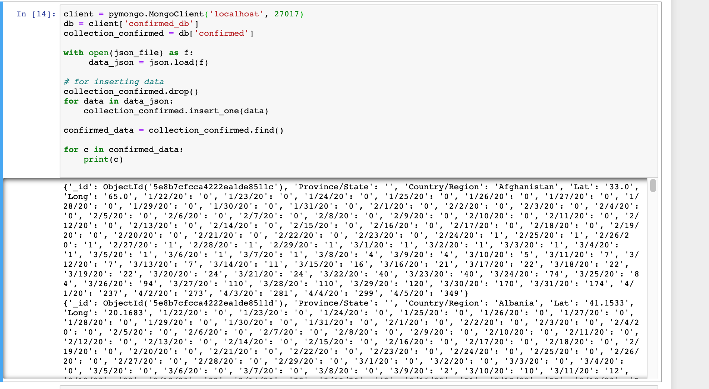
Storing the data in MongoDB and Interacting with database using PyMongo

Slide 10
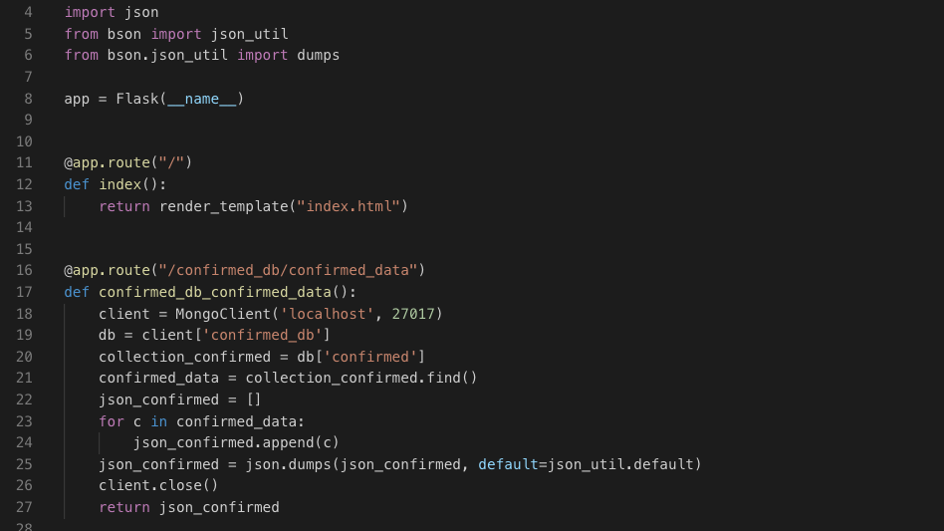
Building the server and Routes
We are using Python Flask for building a server that interact with MongoDB and render the html page that contains our charts. Modifying app.py folder to include the MongoDB query to retrieve all the records from MongoDB along the attributes using separate routes for each database.

Slide 11
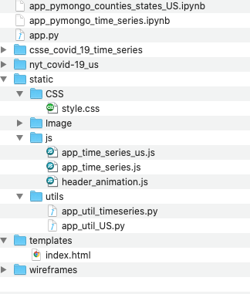
Front-end side preparation
Now that we have the server side code and the MongoDB query ready, we will start building the front end code.
For building the charts, we will be mainly using these list of Javascript libraries d3.js, Leaflet.js, Plotly.js, Google charts, dc Charts ( for filtering the data set) and D3 to do header animation
We will also be using Bootstrap for responsiveness, CSS for styling
Below is the folder structure of our project :

Slide 12
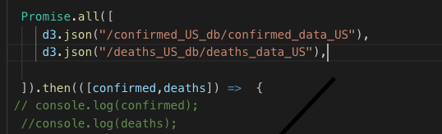
Building the charts
D3.json () promise calls to get the data from the routes to create individual charts :

Slide 13
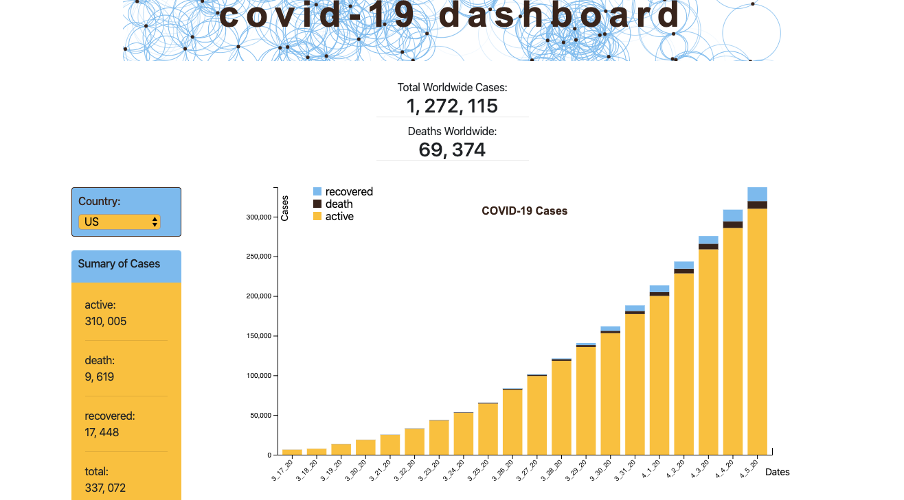
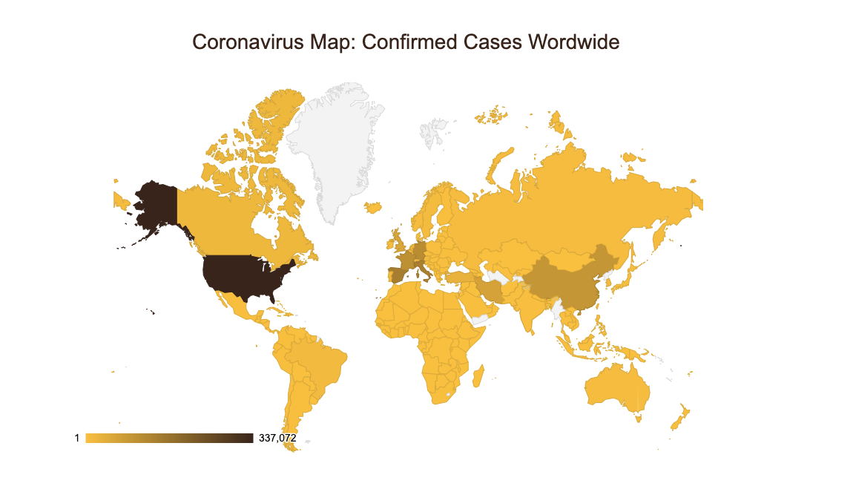
Building the charts ( continued)

Slide 14
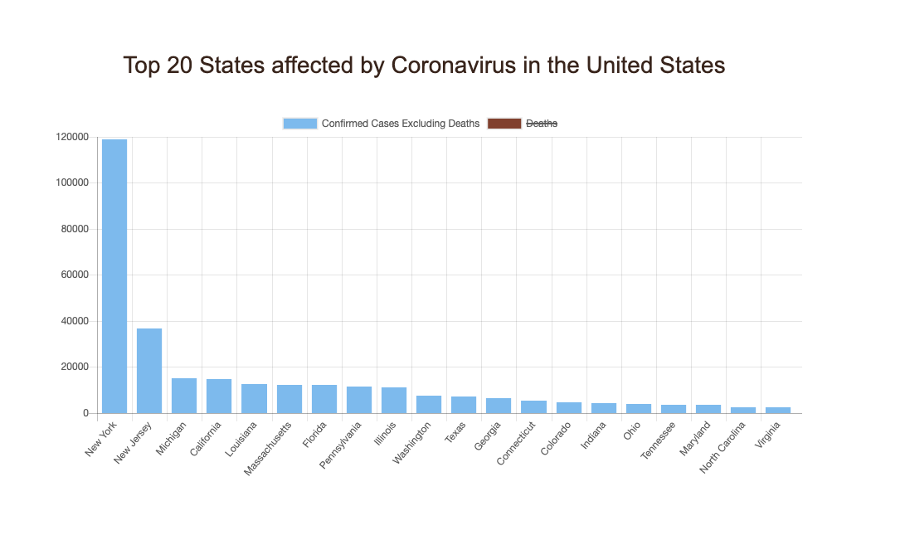
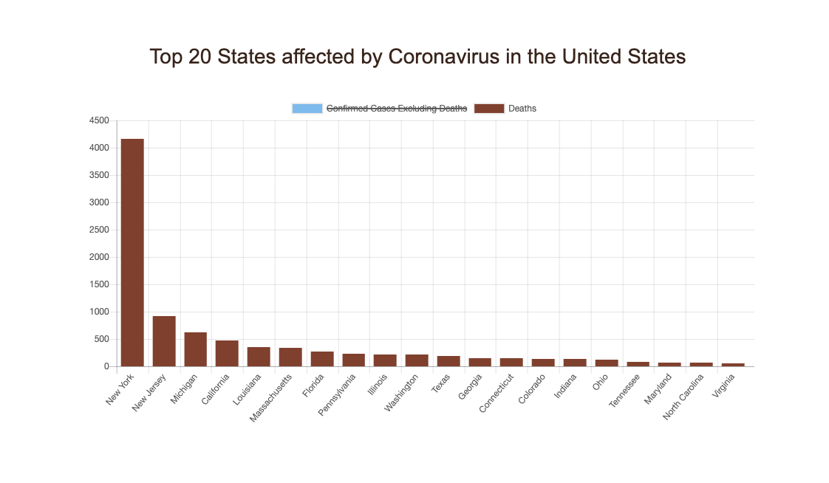
Building the charts with filtering ( continued)

Slide 15


Slide 16


